Slide 1
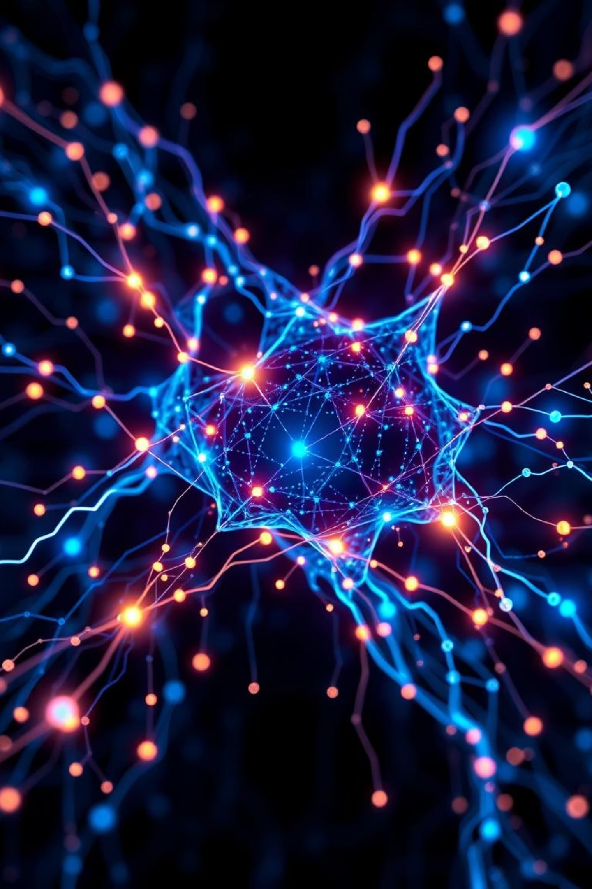
Transformers: The Revolution in Deep Learning
Welcome to an insightful journey into the world of Transformers. These powerful models have redefined deep learning. They excel in understanding and generating human language. Prepare to explore their core components and impact.
by M Ehtesham Ul Hassan Malik
MM

Slide 2


From Sequential to Parallel: Why Transformers Triumphed
The Limitations of RNNs and LSTMs
The Rise of Transformers
Traditional Recurrent Neural Networks (RNNs) and LSTMs process data sequentially. This made them slow for long texts. They struggled with capturing long-range dependencies. Information could be lost over long distances.
Transformers process data in parallel. They are significantly faster. This allows them to handle much longer sequences. They capture relationships across entire texts effectively.

Slide 3





The Building Blocks of a Transformer
Input Embeddings
Words are converted into numerical vectors. These vectors capture semantic meaning. Similar words have similar embeddings.
Positional Encoding
Sequence order is crucial. This encoding adds position information. It helps the model understand word order. This is vital since parallel processing loses order.
Multi-Head Attention
This is the core innovation. It allows the model to "focus" on different parts of the input. It processes multiple aspects simultaneously. This captures diverse relationships.
Feed-Forward Networks
Standard neural network layers process attention outputs. Each position is processed independently. These layers add non-linearity to the model.

Slide 4
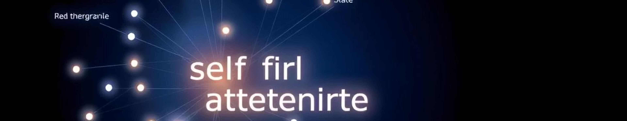
Decoding Self-Attention: "The animal didn't cross the street because it was too tired."
Self-attention determines the importance of other words. For "it" in the sentence, the model attends to "animal". It identifies which words are most relevant. This helps disambiguate meaning.
The model assigns scores to each word. Words with higher scores are more relevant. This dynamic weighting is key. It allows for contextual understanding.

Slide 5

BERT: The Bidirectional Encoder
A Master of Understanding
BERT stands for Bidirectional Encoder Representations from Transformers. It is an encoder-only model. It learns context from both directions. This allows for deep language comprehension.
Key Use Cases
BERT excels in many tasks. These include sentiment analysis. It's great for question answering. It also performs well in text summarization. Its bidirectional nature makes it powerful.

Slide 6

GPT: The Generative Decoder
A Creative Storyteller
GPT stands for Generative Pre-trained Transformer. It is a decoder-only model. It predicts the next word in a sequence. It processes text unidirectionally, from left to right.
Key Use Cases
GPT is famous for text generation. It creates coherent articles. It can write creative content. It powers advanced chatbots. Its strength lies in generating novel text.

Slide 7
BERT vs. GPT: A Comparative Overview
While both are Transformers, BERT and GPT serve different purposes based on their architecture.
Architecture
Encoder-only
Decoder-only
Context
Bidirectional
Unidirectional
Primary Use
Understanding
Generation
Analogy
Detective
Novelist

Slide 8

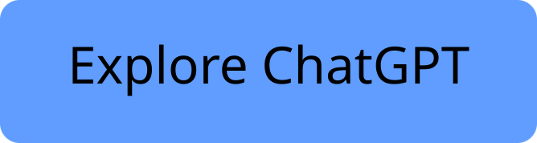

The Transformer Revolution: Powering Modern NLP
Transformers are foundational to modern NLP. They power models like ChatGPT. These models understand and generate human language. They continue to drive AI advancements. Their impact is truly transformative.

